Slide 1
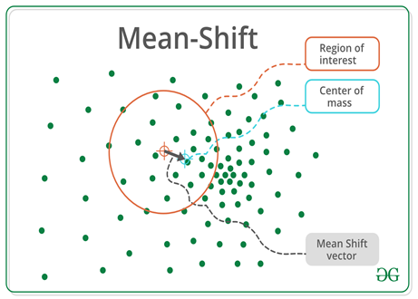
Mean Shift Clustering
Mean-shift clustering is a powerful and flexible non-parametric clustering algorithm that has found applications in various domains such as computer vision, image processing, and bioinformatics.
Mean-shift clustering operates by shifting the mean of a set of points in the feature space until it converges to a dense region, called a mode.
Each mode found by the algorithm is considered to be a cluster.

Slide 2
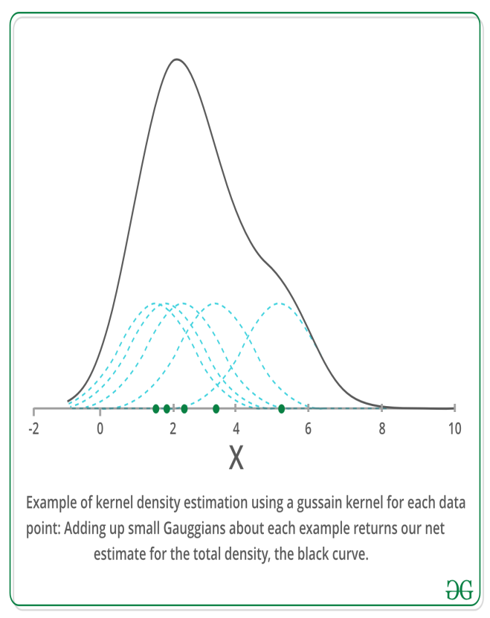
Kernel Density Estimation
KDE is a method to estimate the underlying distribution also called the probability density function for a set of data.
It would help you draw a continuous line that represents the density of those dots, showing where they are more likely to appear
Mean shift clustering is based on the concept of Kernel Density Estimation(KDE)
KDE is a problem where the inferences of the population are made by data smoothing. It works by providing weights to each data point.

Slide 3
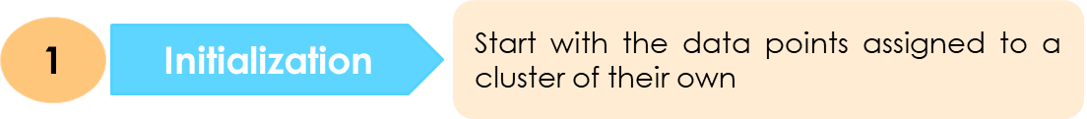
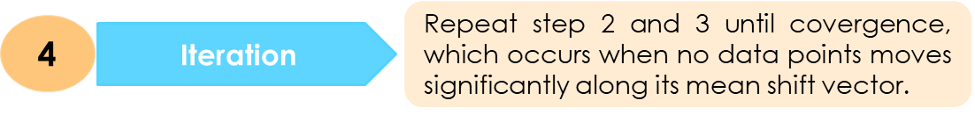
How does Mean Shift Clustering works?
2
For Each Data Point, Calculate the mean shift vector, which point towards the densest region of points in its vicinity.
Mode Seeking
This step effectively shift data points towards denser regions of the data space
3
This step effectively shift data points towards denser regions of the data space
Update Centroids
5
Group data points into clusters based on their final locations
Cluster Formation

Slide 4

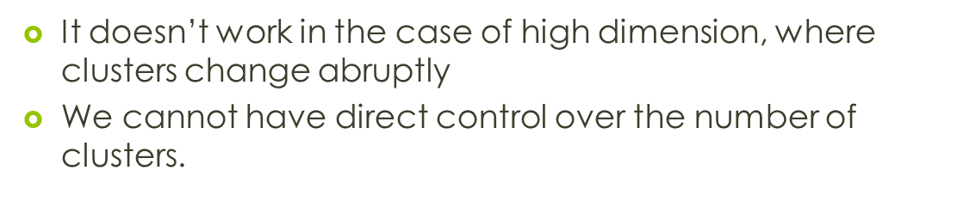
Advantage
It has only one parameter, which determine the number of clusters.
There is no issue of local maximum and assumptions of total clusters.
It also models the complex-shaped cluster.

Slide 5

Application

